Slide 1
🍷 Wine Quality Prediction using Machine Learning
By: Abdul Rahman Mohammed
This project explores multiple machine learning algorithms to predict wine quality using chemical features. It covers data preprocessing, EDA, model training, evaluation, and hyperparameter tuning.

Slide 2
🧩 Project Overview
Objective: Predict wine quality based on chemical properties
Dataset: Wine_Quality.csv
Steps:
Data Preprocessing
Exploratory Data Analysis
Model Building
Evaluation & Hyperparameter Tuning

Slide 3
📊 Dataset Description
Total Rows: 1599 (approx.)
Features: 12 numeric + 1 target (quality)
Target Variable: quality
Removed ID column as identifier

Slide 4
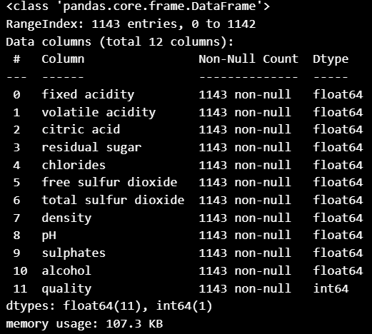
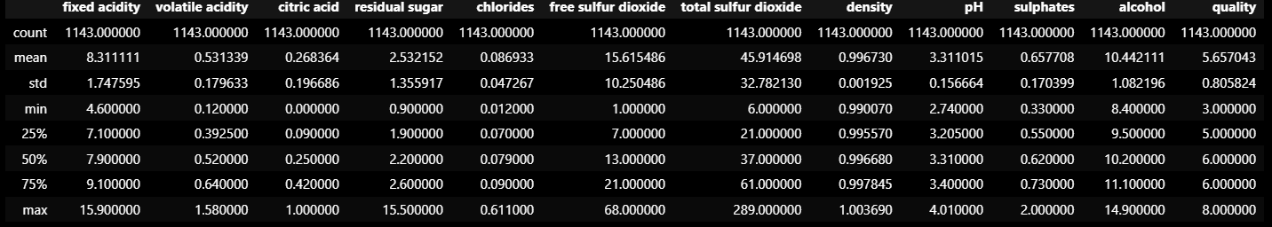
Screenshot: df.info() & df.describe())

Slide 5
🔍 Exploratory Data Analysis (EDA)
• Checked missing values
• Rounded numeric columns
• Examined correlations
• Notable correlation between alcohol, volatile acidity, and quality

Slide 6
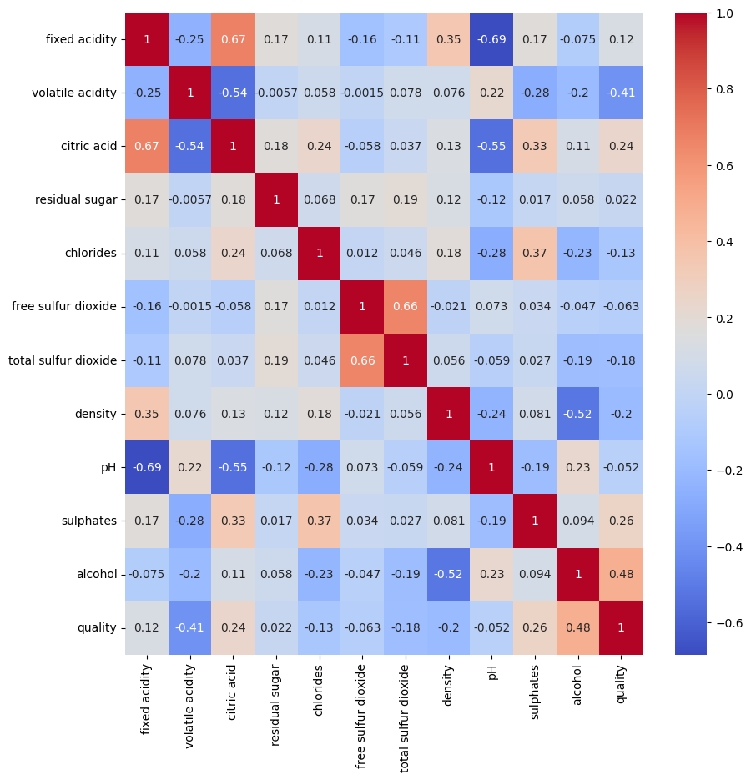
(Screenshot: Correlation Heatmap)

Slide 7

📈 Simple Linear Regression
Model: Linear Regression
Performance Metrics:
R² Score ≈ 0.34
RMSE and MAE calculated
Shows linear relation between features and quality

Slide 8
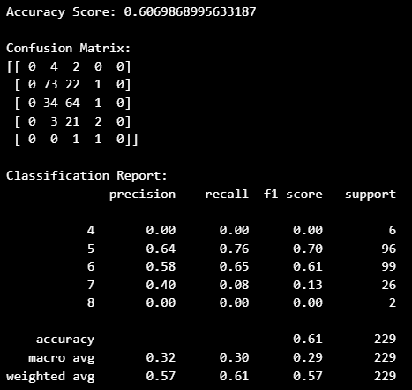
🔢 Logistic Regression
Used for classification
Evaluated with Accuracy, Confusion Matrix & Classification Report

Slide 9
👥 K-Nearest Neighbors (KNN)
• Distance-based classifier
• Default n_neighbors=5
• Visualized confusion matrix

Slide 10
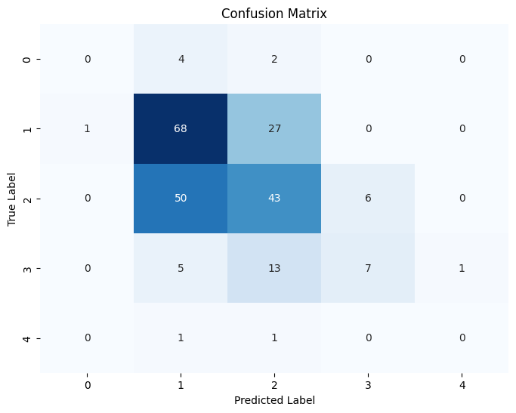
Screenshot: KNN Heatmap

Slide 11
🧮 Naive Bayes Models
Implemented:
GaussianNB
MultinomialNB
BernoulliNB
Compared accuracy visually

Slide 12
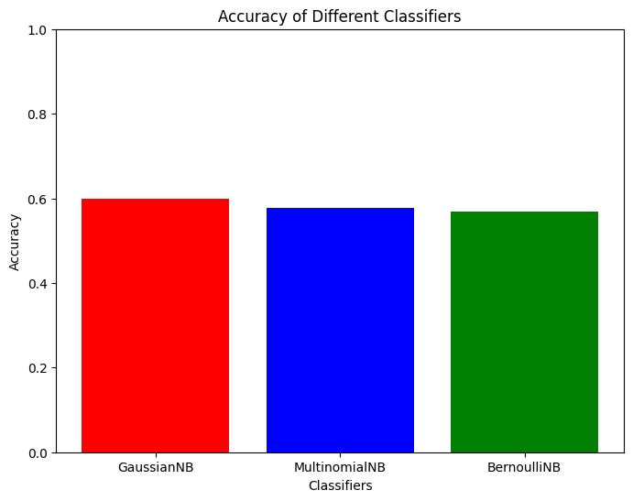
Screenshot: Accuracy Bar Chart

Slide 13
🌳 Decision Tree Regressor
Model: DecisionTreeRegressor
Evaluated regression metrics
Visualized top feature importances

Slide 14
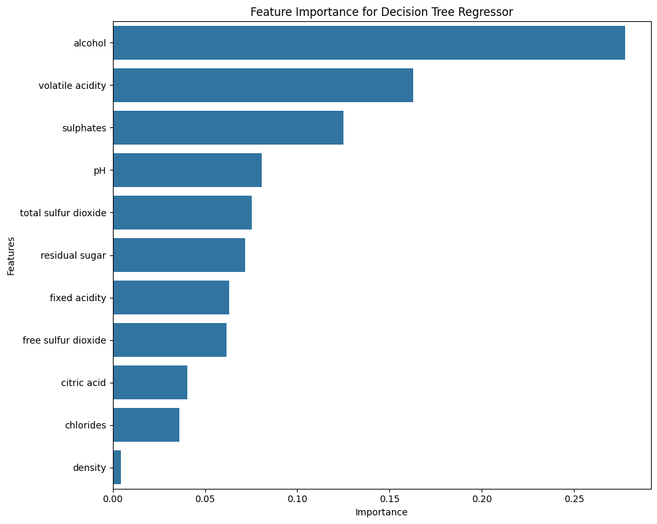
Screenshot: Feature Importance Plot

Slide 15
⚙️ Support Vector Machine (SVM)
Kernel: RBF
Used standardized data
Evaluated with confusion matrix & classification report

Slide 16
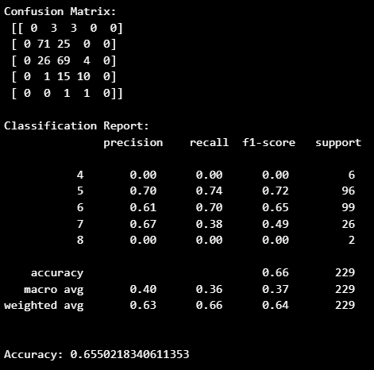
Screenshot: SVM Evaluation

Slide 17
🔍 Hyperparameter Tuning
Used GridSearchCV for:
Logistic Regression
KNN
Linear Regression
5-Fold Cross Validation applied

Slide 18
🧾 Final Comparison & Conclusion
Tuned Model Results:
Best Logistic Regression Accuracy
Best KNN Accuracy
Best Linear Regression R²
Best Performer: Based on evaluation metrics
Successfully implemented full ML workflow

Slide 19
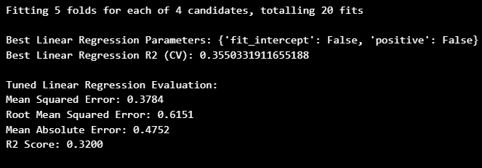
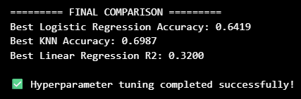
Screenshot: Best Params & Scores Output

Slide 20
🎓 Conclusion
Among all models tested, Logistic Regression and KNN delivered the most consistent and accurate predictions after hyperparameter tuning.
Linear Regression provided a moderate correlation (R² ≈ 0.34), indicating that wine quality is influenced by multiple nonlinear interactions between features.
Naive Bayes models performed reasonably but were less suitable for continuous numeric data without strong independence assumptions.
Decision Tree Regressor offered good interpretability and feature importance insights, identifying alcohol, volatile acidity, and sulphates as key quality indicators.
Support Vector Machine (SVM) gave solid results after tuning, but required more computation time.
Hyperparameter tuning using GridSearchCV significantly improved the model performance, proving the importance of optimizing model parameters rather than relying on defaults.

Slide 21
THANK YOU!

